Slide 1











BSB00172 SturNet
Network for the Preservation of Sturgeon and for the Sustainability of the Black Sea Basin Ecosystem
www.sturnet.eu
Programme priority:
Blue and Smart Region
SturNet on: Facebook, Linkedin, Twitter
sturnetproject@gmail.com

Slide 2
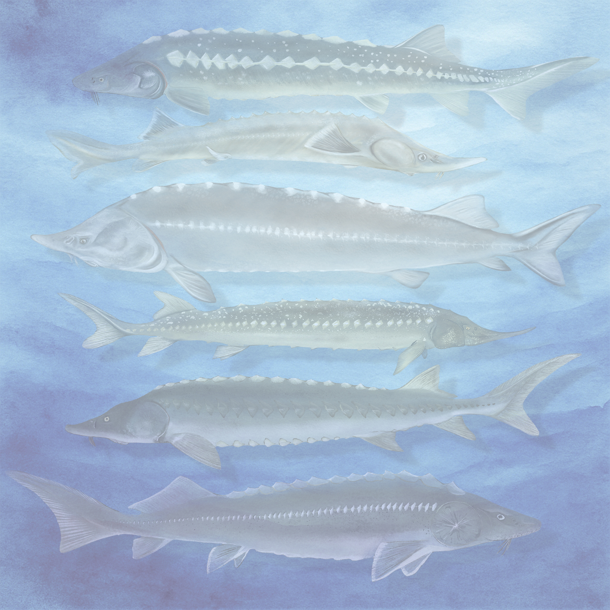

Critically endangered
Sturgeons, are among the world's most valuable wildlife resources, but today are the most threatened animals on
the IUCN
www.sturnet.eu
Programme priority:
Blue and Smart Region
www.sturnet.eu
SturNet on: Facebook, Linkedin, Twitter
sturnetproject@gmail.com
BSB00172 SturNet
Network for the Preservation of Sturgeon and for the Sustainability of the Black Sea Basin Ecosystem

Slide 3
Main objectives
The SturNet project is a collaborative effort involving 6 organizations across Bulgaria, Romania, Moldova, Turkey, Ukraine, and Greece.
It aims to:
Develop and pilot a digital mapping tool to monitor sturgeon habitats and migration routes.
Enhance transnational cooperation among stakeholders for sturgeon conservation.
Raise awareness among policymakers and the public about sustainable exploitation and biodiversity
Project Duration: 30 months
08/2024 - 02/2027
Total budget: 1 148 409,60 Euros
EU funding: 1 033 568,60 Euros

Slide 4
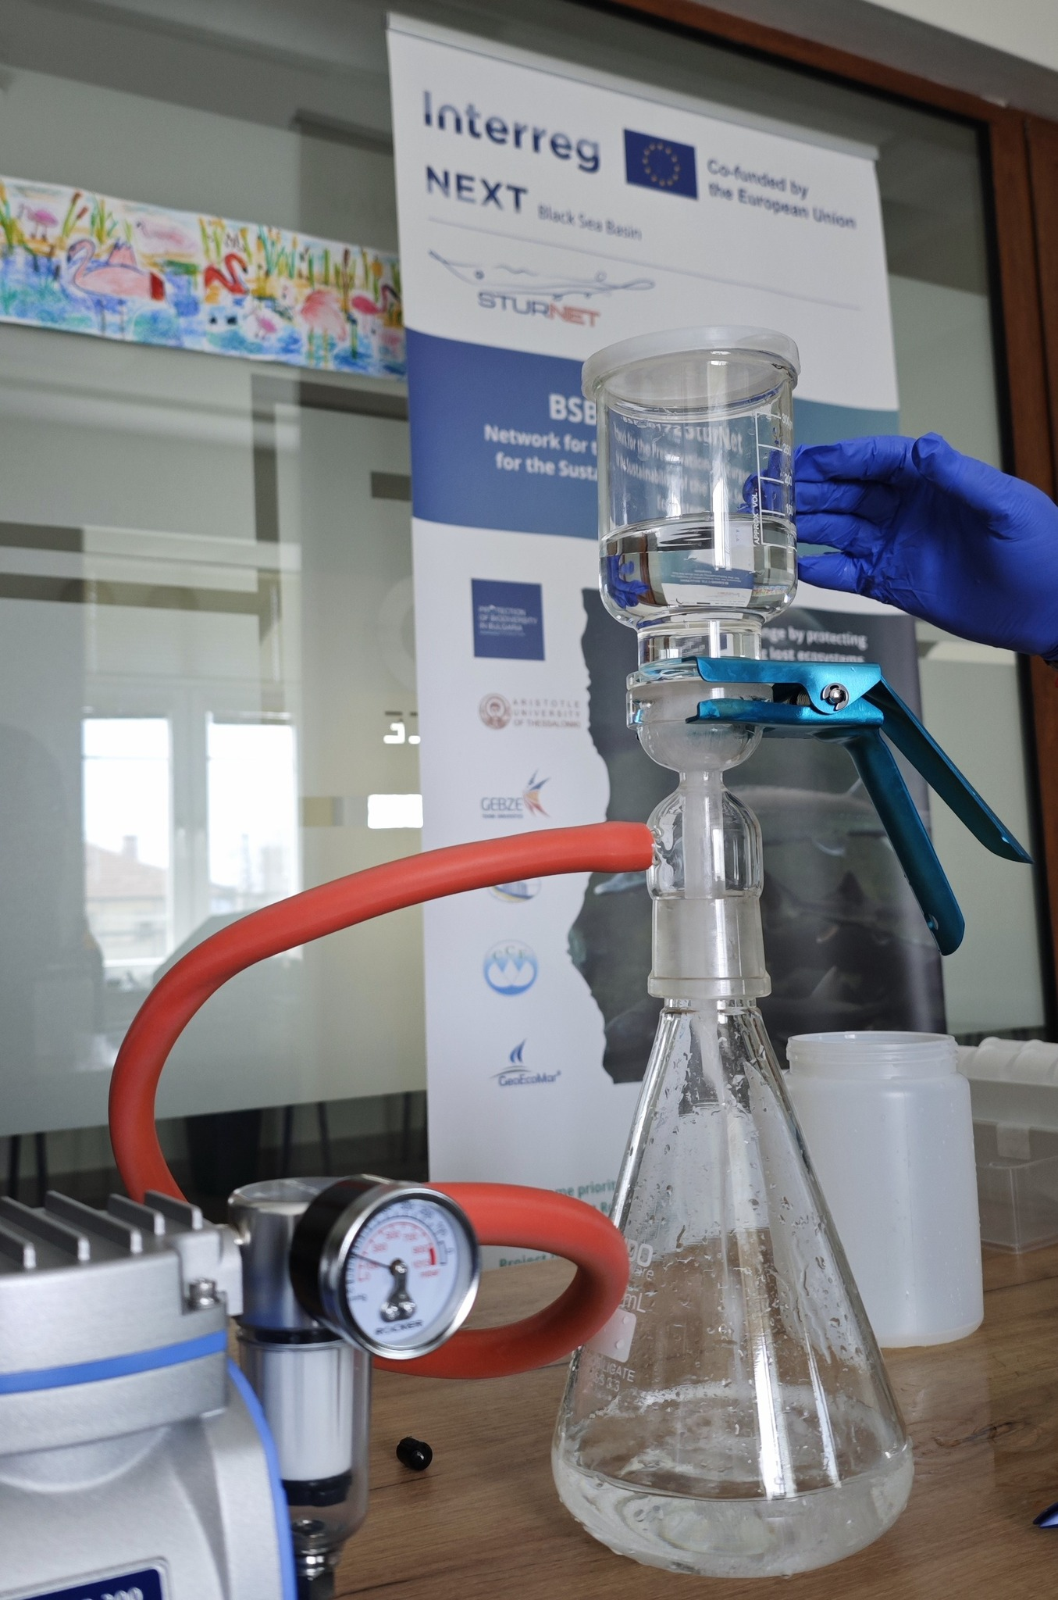
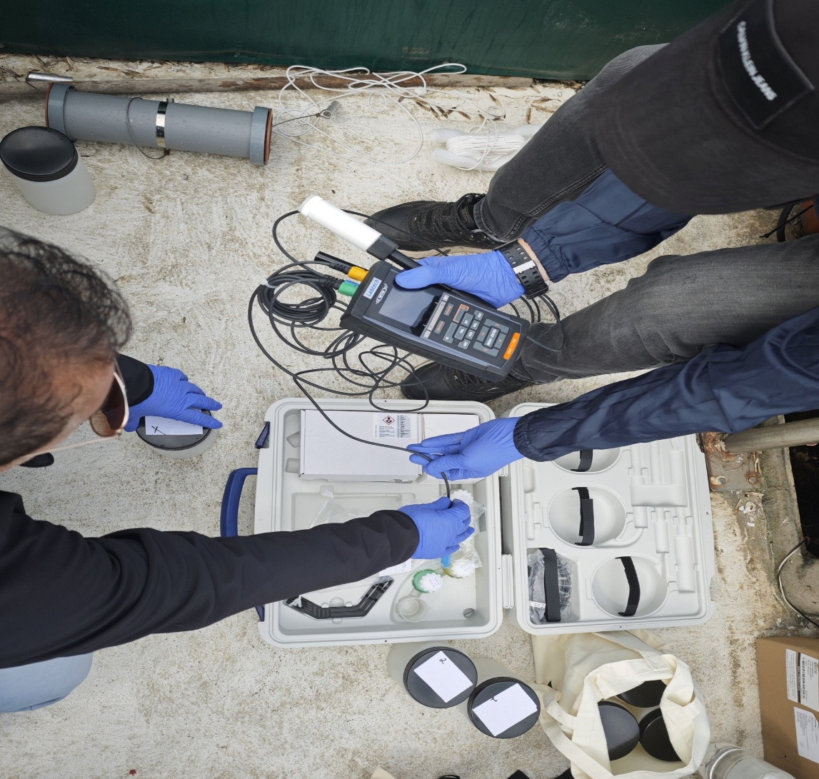
In our project, “SturNet”, to respond to the critical challenges that all Black Sea
countries face, related to the preservation of sturgeon and the Basin’s overall maritime biodiversity, through primary
research, data collection and model development
www.sturnet.eu
SturNet on: Facebook, Linkedin, Twitter

Slide 5
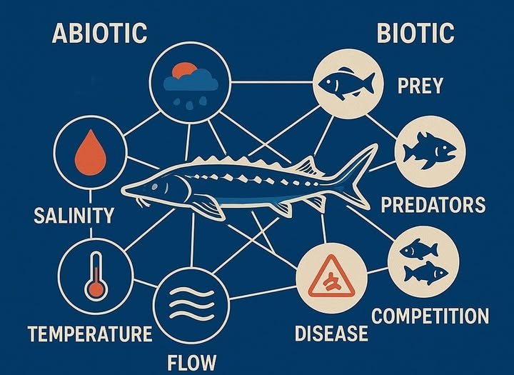

Pollution and destruction of natural watercourses and habitats, illegal harvest and trade have put their existence at risk, affecting their breeding grounds.
Sturgeon population declined by 70% over the last century
By connecting the dots, we aim to reveal how multiple pressures shape migration and survival of sturgeons.
www.sturnet.eu
SturNet on: Facebook, Linkedin, Twitter

Slide 6
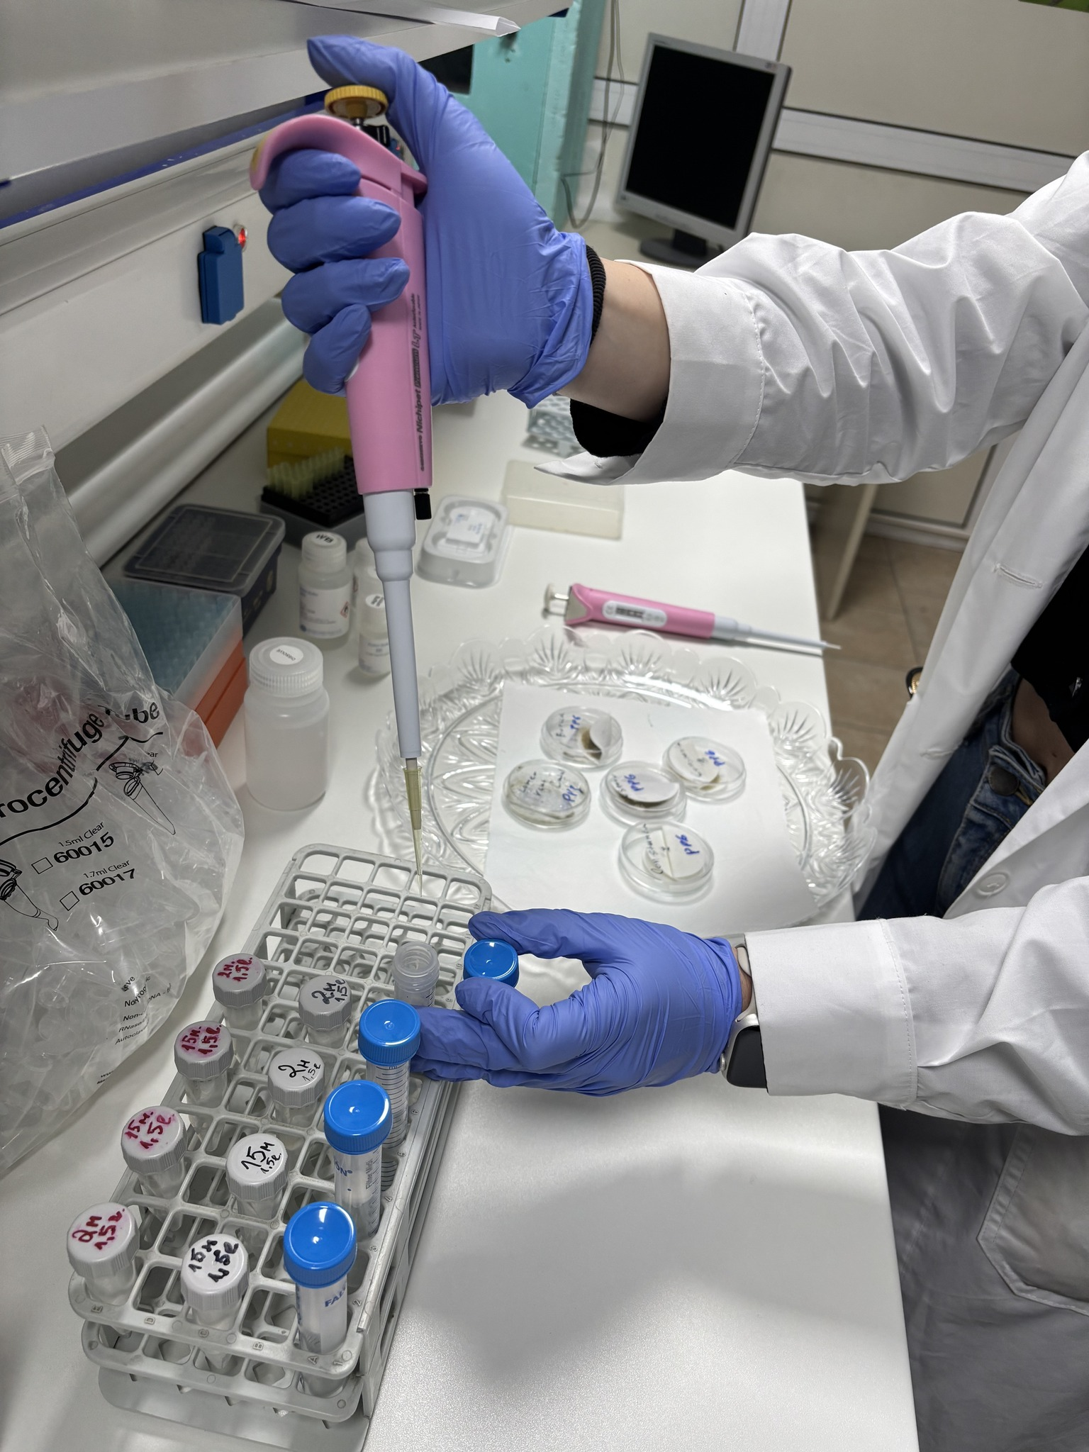
Environmental DNA (eDNA)
-Non-invasive Sampling: Collects DNA from water without harming wildlife.
-Biodiversity Assessment: Detects a wide range of species, including rare and elusive ones like sturgeons.
-Early Detection of Invasive Species: It can be used to identify threats before they become established.

Slide 7
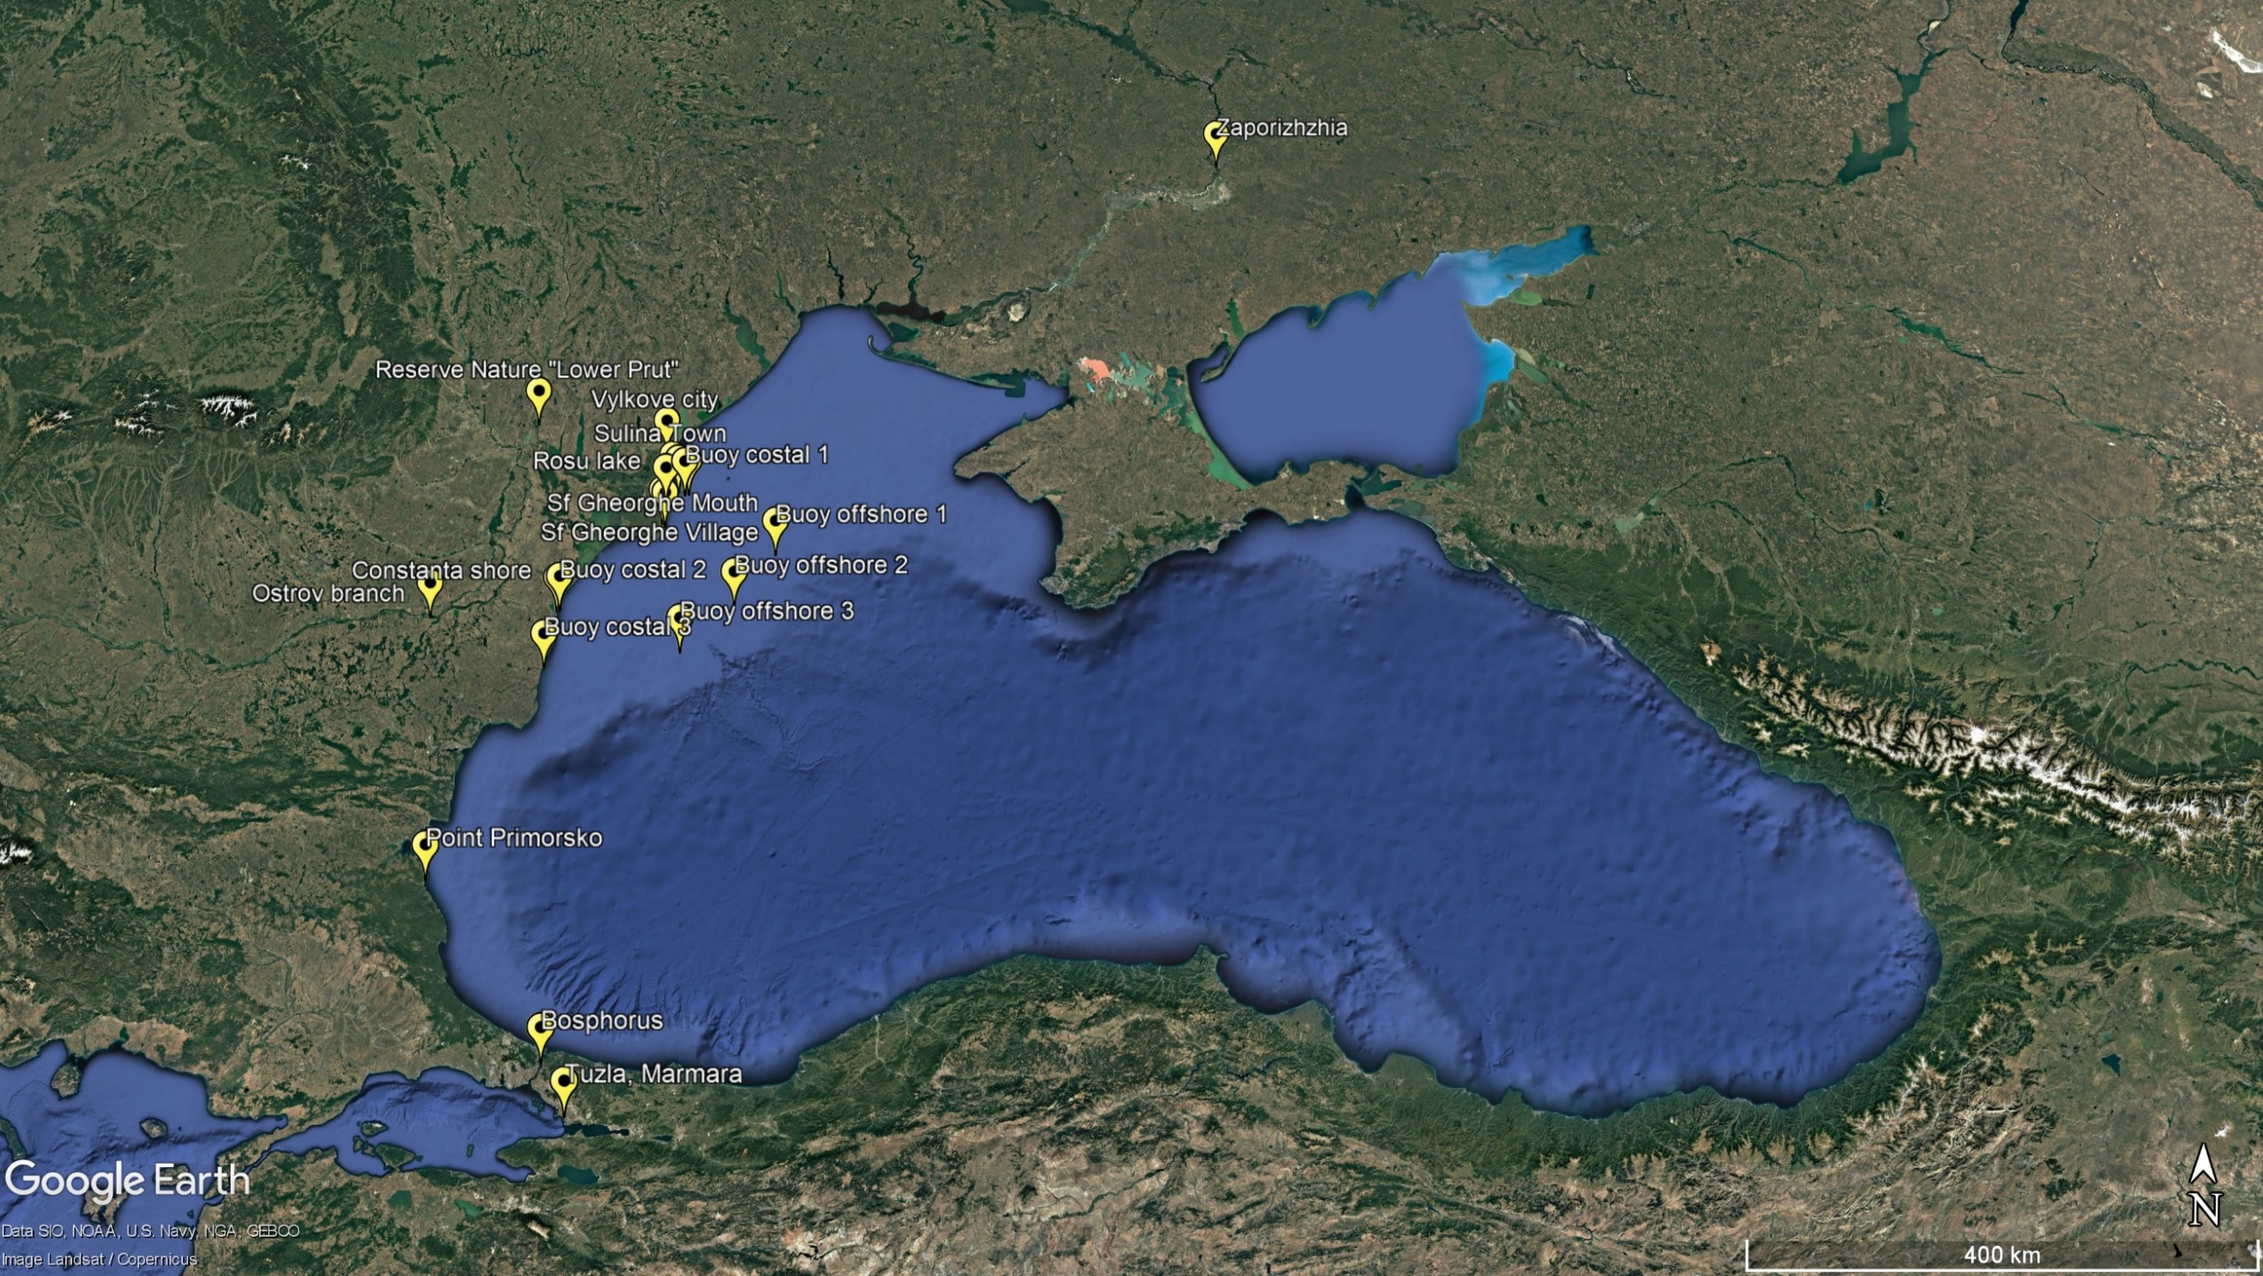
JOIN our Transnational Sturgeon Network "SturNet"
The sea belongs to everybody and nobody at the same time
www.sturnet.eu
SturNet on: Facebook, Linkedin, Twitter
sturnetproject@gmail.com

